Slide 1
Building the Operating System for Off-Grid Energy
A Strategic Vision for Dominance in a New Era of Energy & Computation
Colin Aulds, Co-Founder & CTO, 10NetZero

Slide 2

The Architect Behind the Engine
Colin Aulds, Co-Founder & CTO
LLM and Bitcoin Crossover
Digital Intelligence Layer Focus
Deep understanding of the underlying architecture of both LLMs and Bitcoin
Building competitive edge while partners handle energy production
Efficiency-Focused, Growth Obsessed
Near-term ROI-positive platform + long-term R&D initiative

Slide 3
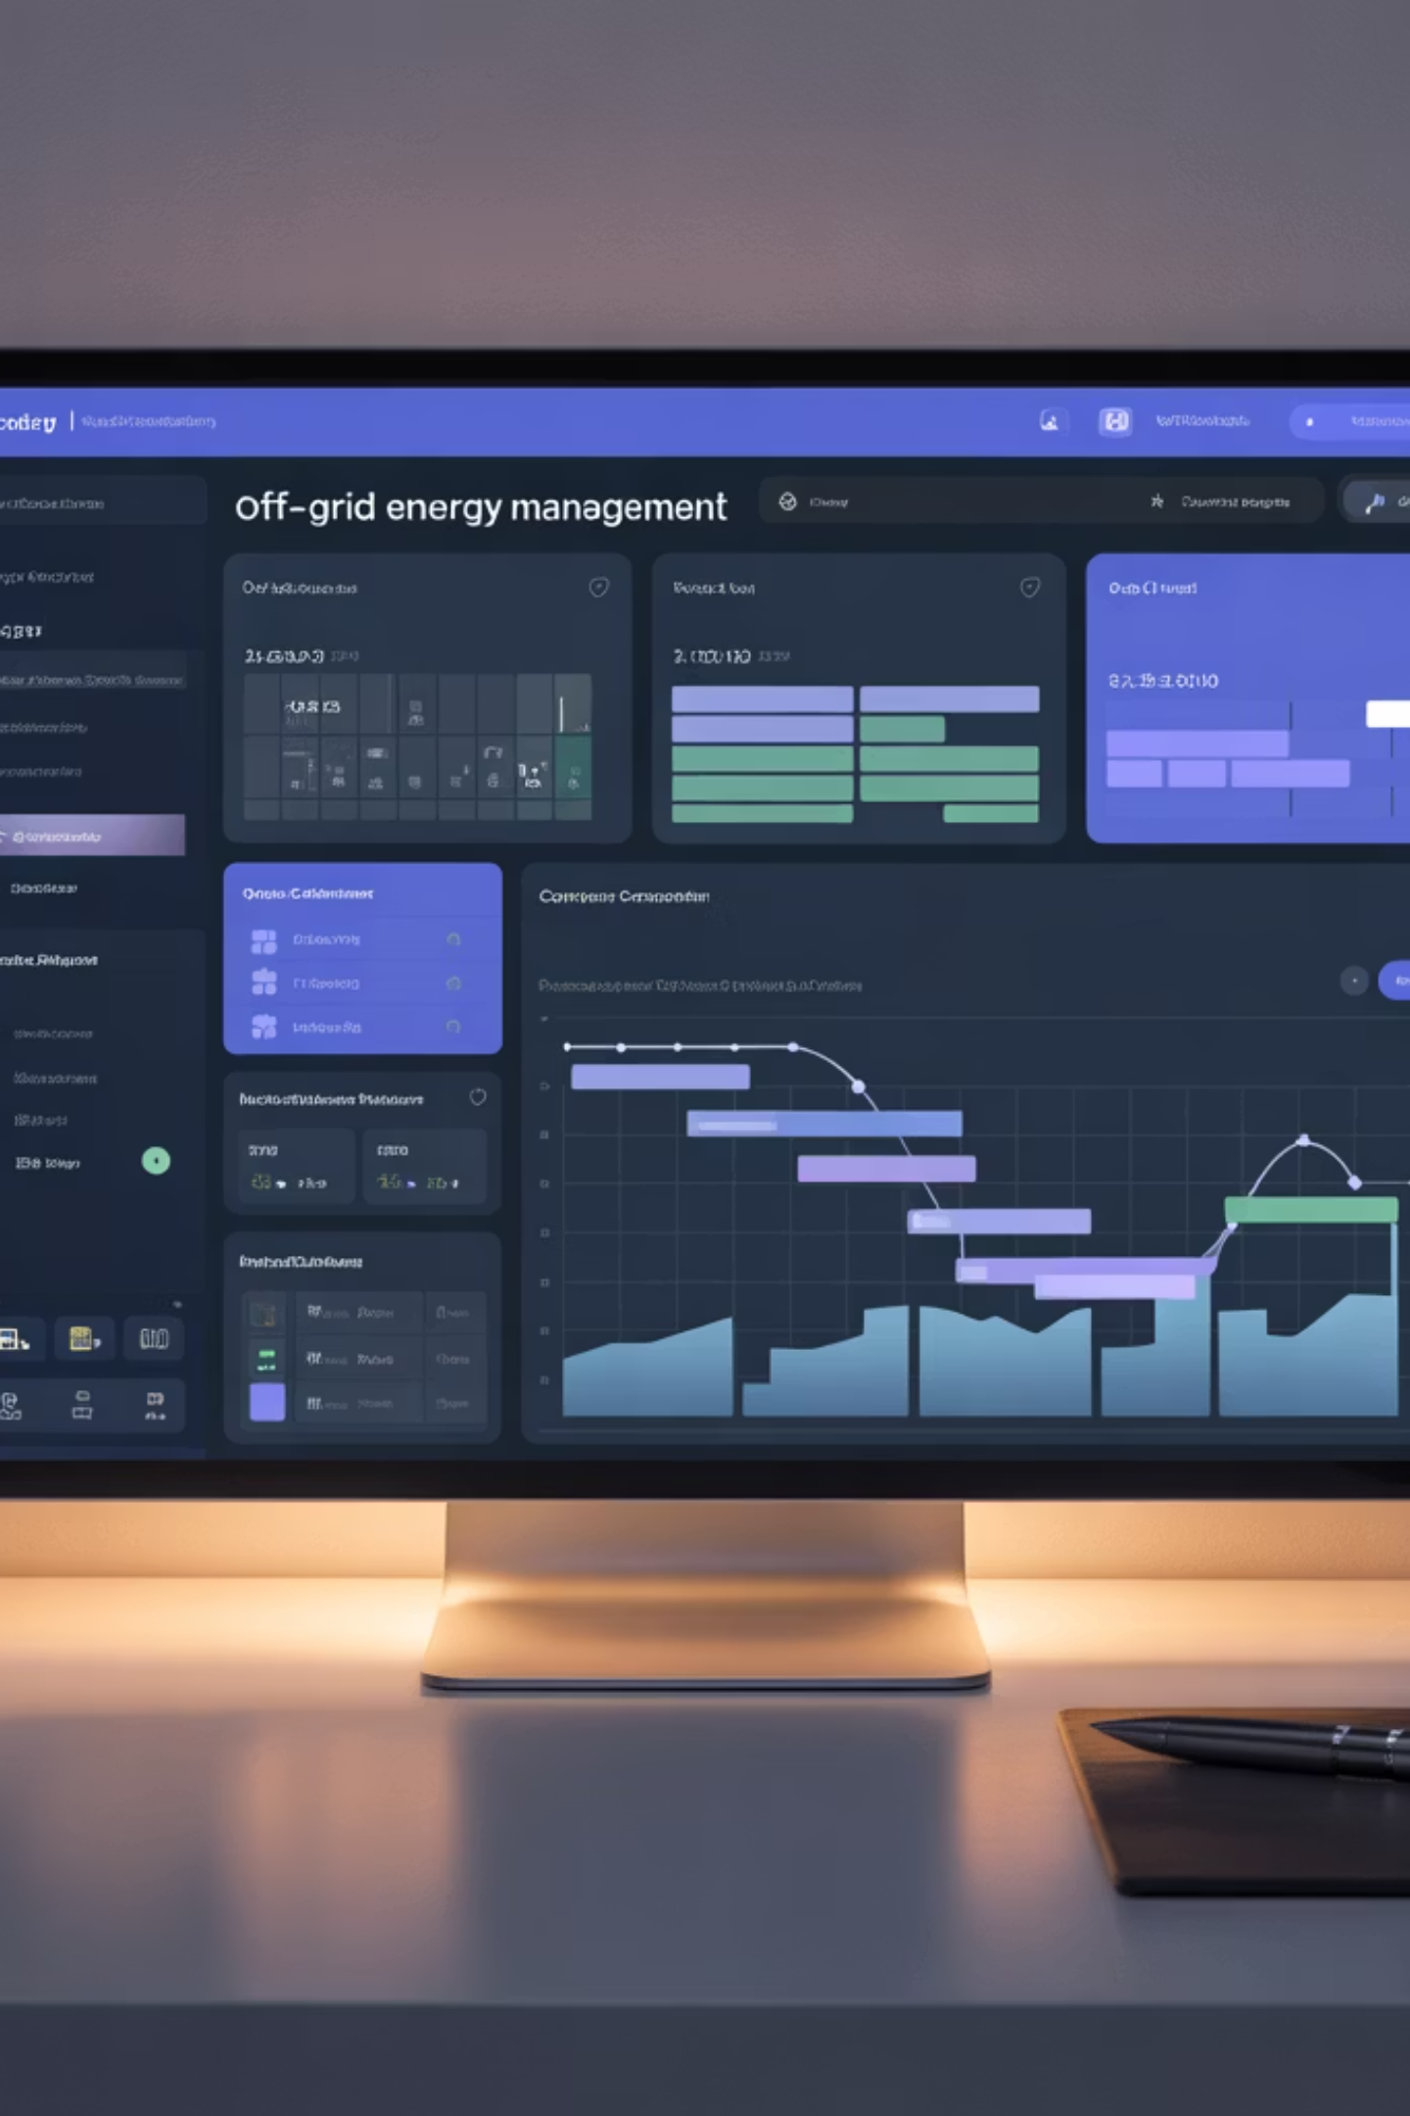
The Grand Vision
The Operating System for Off-Grid Energy
Management
Centralized operations control
Communications
Integrated connectivity layer
Operations
Automated workflow systems
Efficiency
AI-driven optimization
Master our operations first, then set the industry standard

Slide 4
Strategic Roadmap & Investment
Phase 1: Foundation
Phase 3: Dominance
The Company Brain
Build the Moat
Centralize all knowledge
Project Pythia (Predictive AI)
Q4 2025
Q2-Q4 2026
1
2
3
4
Phase 2: Intelligence
Phase 4: Moonshot
Activate the Brain
Redefine the Market
Deploy Smart Agents & Tools
Off-Grid AI Inference R&D
Q1-Q2 2026
2027+

Slide 5
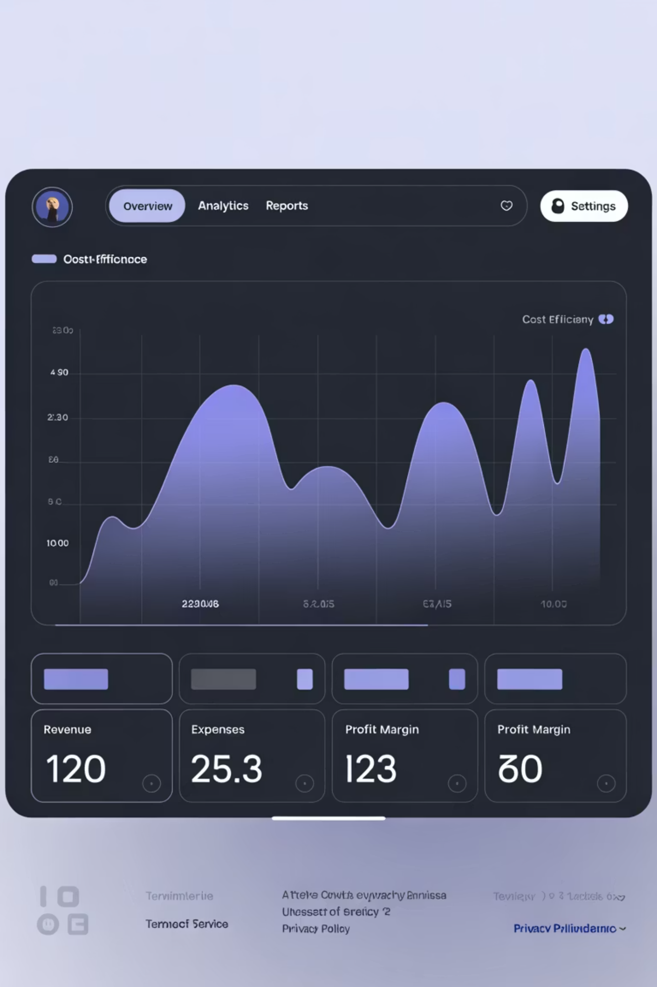
Lean Foundation Built
01
Problem Identified
Knowledge scattered, high-friction task management
02
Solution Deployed
MVP on Supabase + OpenProject self-hosted
03
Breakthrough Achieved
Frictionless Telegram Bot API for 100% data capture
04
Capital Efficiency
Total infrastructure cost: $25/month

Slide 6

Phase 1: The Company Brain
Our Single Source of Truth (SSOT)
All business data—from field operations to financial records—flows automatically into one central, intelligent Supabase repository. This brain becomes the foundation for all future insights, automation, and AI.
Financials
Field Ops
ERP system transactions
Reports from crews
The Brain
Telemetry
Comms
Foreman, SCADA, Live Weather
Slack/Telegram channels and email streams

Slide 7



Phase 2: The Workers
Smart Agents Activation
SiteGPT
Talk2Comms
FLRTS NLP
The AI Oracle for every mining site. It instantly answers technical questions using all site-specific documents and live data + plus a corpus of general knowledge useful for team members when troubleshooting or integrating.
Talk to your chat history and easily find that comment made by the field team leader about Genny A at Eagle Lake or create rich timelines with sources, all on-the-fly for use in insurance claims, lawsuits, demands, or just situational awareness. Team members are no longer delayed while performing admin tasks that waste time.
Frictionless Field Operations & Tasking. This NLP layer enables field staff to create Field Reports, Lists, Reminders, and Tasks from simple Telegram messages, translating natural language into structured items for our central project management system.

Slide 8
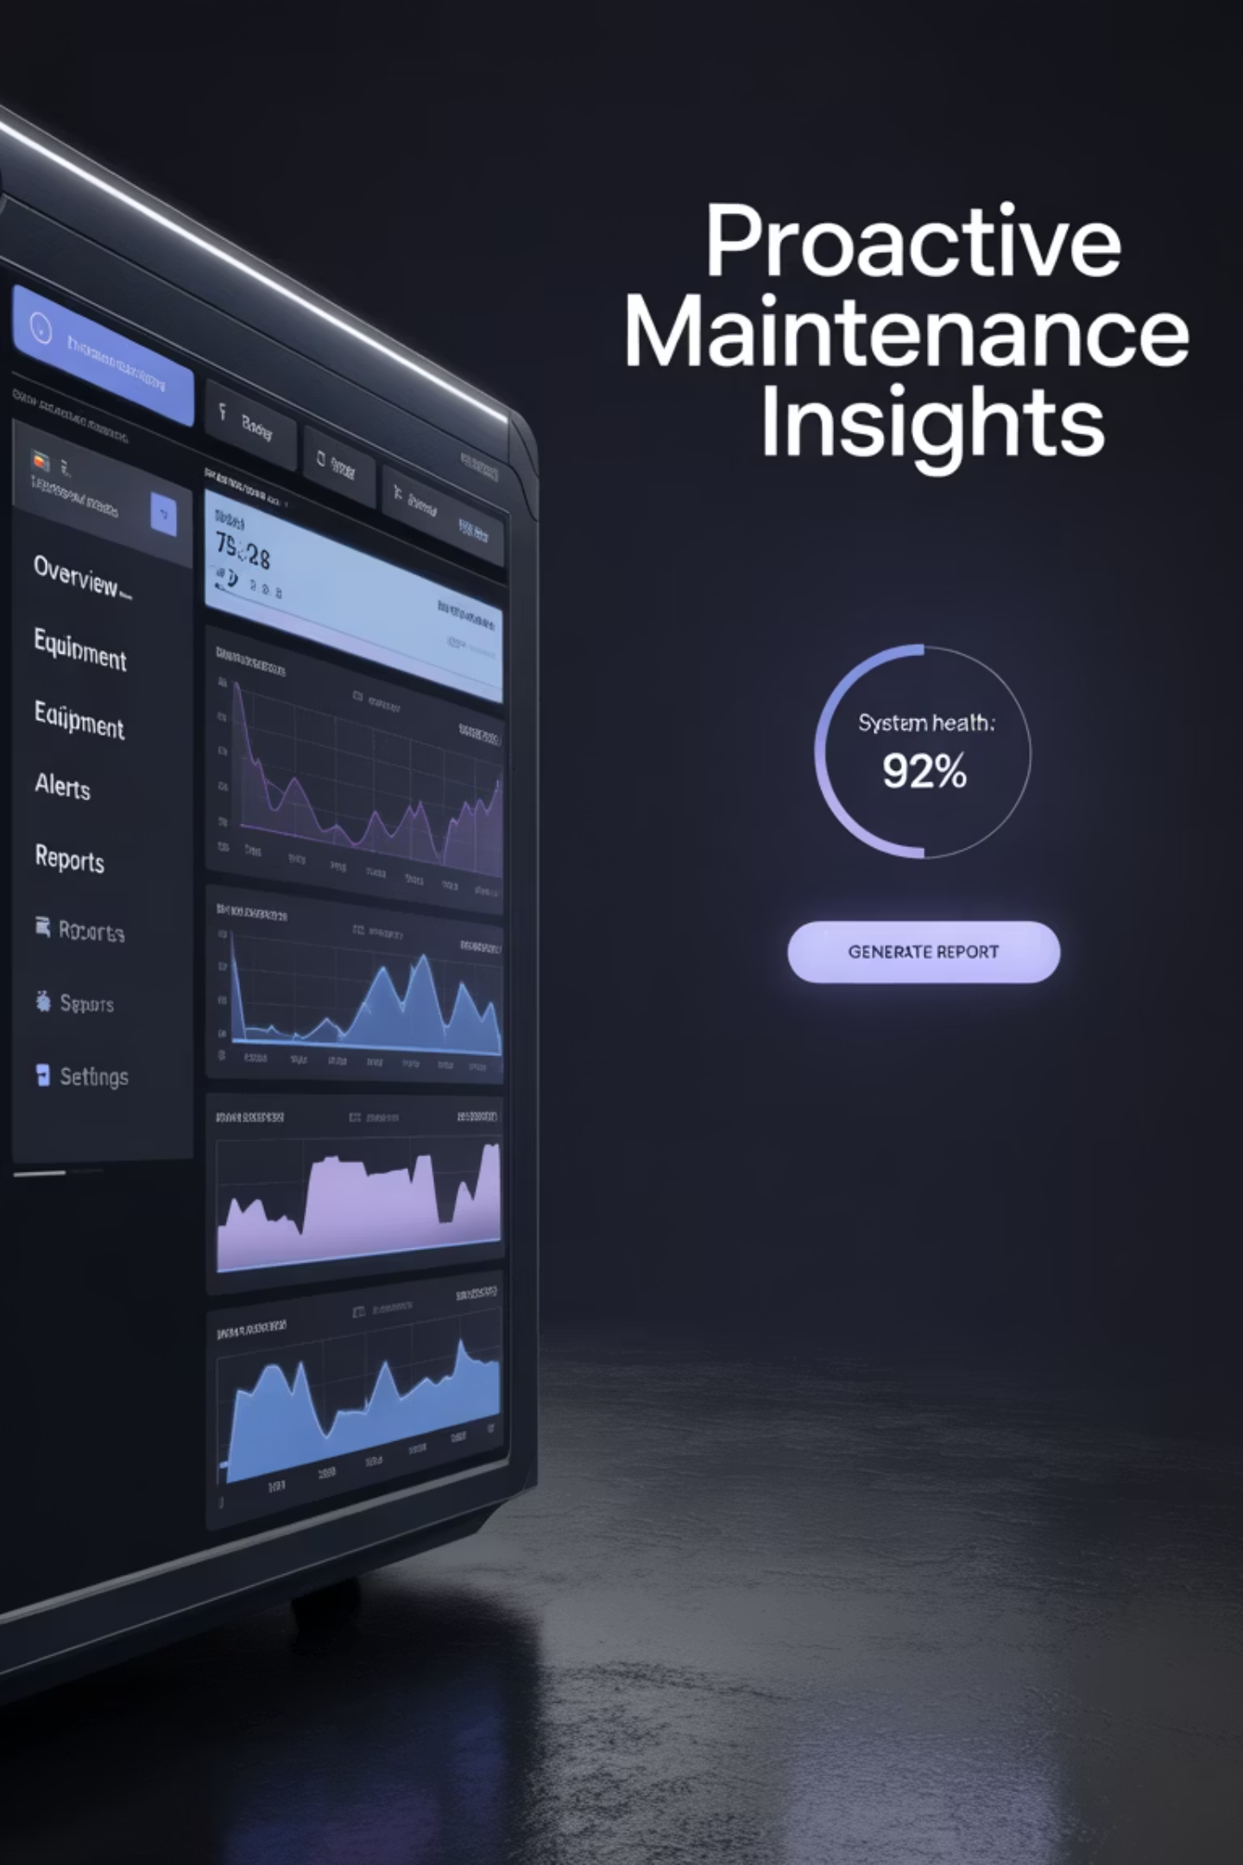



Phase 3: The Nervous System
Project Pythia Moat
Goal: 97%+ Uptime
ML-powered equipment failure prediction
Strategic JV Partner
Joint Venture with Digital Carpenters
Hybrid Financial Model
Cost-Plus-Fixed-Fee → Revenue-Share transition
Phase 1: Development
Phase 2: Commercialization
Cost-Plus-Fixed-Fee model guarantees delivery
Revenue-Share creates long-term growth alignment

Slide 9





The Flywheel Effect
Attract Partners
Superior Operations
Gain Data
Smarter AI
First Mover = Data Moat
We must act now

Slide 10
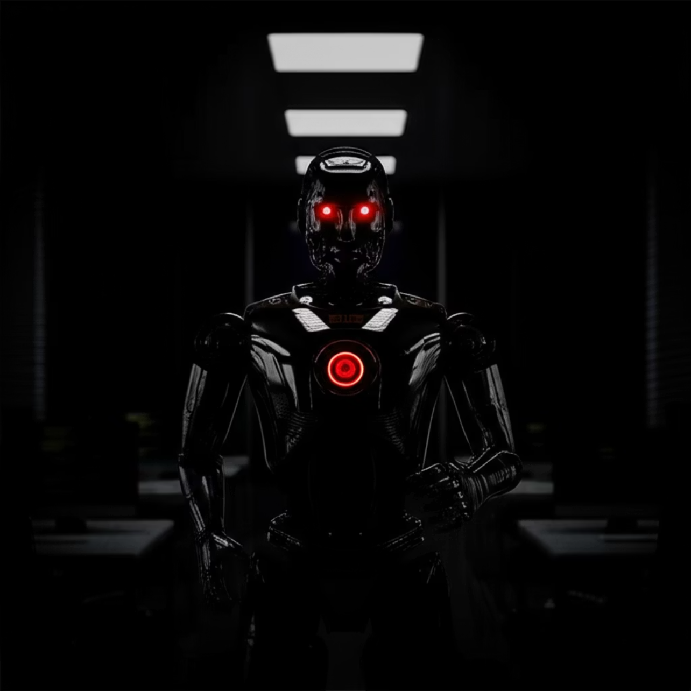
Proactive AI Governance
Safety as Core Design Principle
Prompt Injection
Data Poisoning
Mitigated with security middleware and minute-by-minute snapshots.
Robust validation pipelines
Mesa-Optimization
Human-in-the-loop oversight & monitoring
Robust governance = competitive advantage

Slide 11






Phase 4: The Moonshot
Off-Grid AI Inference
Our long-term strategy focuses on three key areas:
Technical Plan: Power Smoothing
This robust system ensures uninterrupted, high-quality power delivery for our AI inference operations, optimizing performance.
Leveraging our off-grid power to build a distributed AI compute network, ensuring resilience and scalability.
Variable Power Input
The core of our off-grid system relies on a Cat NG Generator, which requires stable load. This variability needs careful management to ensure stable operations and a software layer on top to coordinate firmware and load.
Diversifying our revenue stream beyond cryptocurrency market volatility, creating a more stable business model.
Battery Energy Storage System (BESS) Buffer
Our integrated Battery Energy Storage System acts as a critical buffer, effectively smoothing out the variable power requirements of a hybrid system.
Stable Power Output for AI
Becoming a first mover in the emerging market for low-cost, distributed AI compute, setting industry standards.
The result is a precisely regulated power supply that gives hardware time to get into the state that it needs to produce inference deliverables.

Slide 12



The Ask: Fueling Growth
Total Request: $2.63M in budget + 1% in BigSur vested over a year.
Core Intelligence Platform
Off-Grid AI Inference R&D
3-Year Budget: $761,580
2-Year Initial: $1,870,710
Senior developer: $236,250/year
NVIDIA DGX H100: $450k
JV partnership: $50,000
1 MW / 2 MWh BESS: $450k

Slide 13
Honest Risk & Reward Assessment
$3,350
Daily Opportunity Cost
Foregone Bitcoin mining profits at current rates
Strategic Risk Mitigation
Hedge Against Crypto Volatility
Start Small with Test/Dev Cluster
Explore GPU Hardware Leasing
Distributed AI compute offers larger, stable market
Prove concept before full-scale commitment
Reduce CapEx and protect against obsolescence

Slide 14
Building the Machine
That Builds the Machine
Foundation Built
De-risked Plan
Competitive Moat
Core systems operational
Phased approach with clear milestones
Clear path to unbeatable advantage
"The factory is the product."
— Elon Musk

